Slide 1
Multiple Linear Regression Analysis of Citi Bike Ridership Data
Javier Lopez

Slide 2

About Me
Hello everyone,
I'm Javier Lopez, and I'm thrilled to be here today as a Data Analyst. I have a genuine passion for uncovering intricate patterns and insights hidden within data. My expertise spans statistics, programming, and data visualization, enabling me to transform raw data into strategies that drive informed decision-making. With a track record of delivering valuable insights, I've helped organizations optimize processes and gain a deeper understanding of market trends. I'm excited to share my knowledge and contribute to our projects by embracing the power of data analysis.
Thank you for having me.

Slide 3
The Problem
Developing an accurate predictive model for Citi Bike ridership demand is essential to optimize resource allocation and operational efficiency. The challenge lies in capturing the dynamic factors influencing ridership, including weather, seasonality, and external events.
Research Question
Null Hypothesis
Alternative Hypothesis
Can Citi Bike ridership demand be predicted using a model based on market research data?
Citi Bike ridership demand cannot be predicted using a model based on market research data with an accuracy greater than 70%.
Citi Bike ridership demand can be predicted using a model based on market research data with an accuracy greater than 70%.

Slide 4
The Data Analysis Process
Data Collection & Preprocessing
Gather historical Citi Bike ridership, weather, and NYC bicycle count data, and prepare it for analysis.
05
Predictive Model Comparison
Compare the predictive accuracy of each algorithm’s best model using the best prediction timeframe identified during model refinement.
01
04
Predictive Model Refinement
Iteratively refine the model by comparing each model’s predictive accuracy with different parameters and prediction timeframes.
Data Exploration
Uncover weekly, monthly, and yearly ridership trends and identify relationships between ridership and factors such as weather, time, effects from holidays, and the pandemic.
02
03
Predictive Model Development
Create and test predictive models using two types of algorithms, Ridge Regression and ARIMA.

Slide 5
The Findings
Data Exploration
Model Development

Slide 6
The Findings
Weekly, Monthly, and Yearly Trends
Seasonal Distribution
Correlation Analysis
Holiday Influence
Covid-19 Impact
Weekday and Pandemic Period
Data Exploration

Slide 7
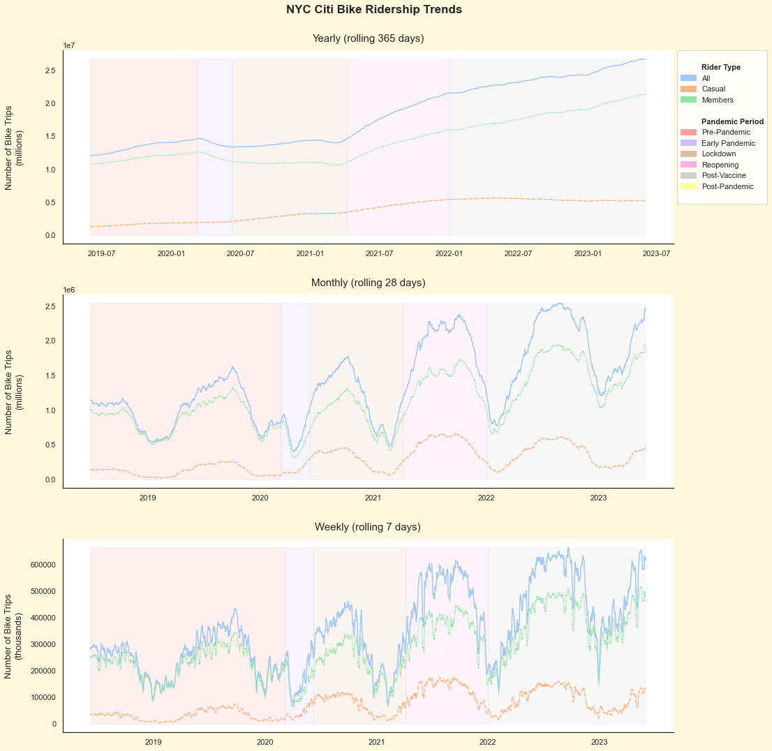
Weekly, Monthly, and Yearly Trends
Plotting the weekly, monthly, and yearly total bike trips revealed a cumulative trend across successive years with a temporary downturn during the initial pandemic period.
Plotting the weekly, monthly, and yearly total bike trips revealed a cumulative trend across successive years with a temporary downturn during the initial pandemic period.

Slide 8
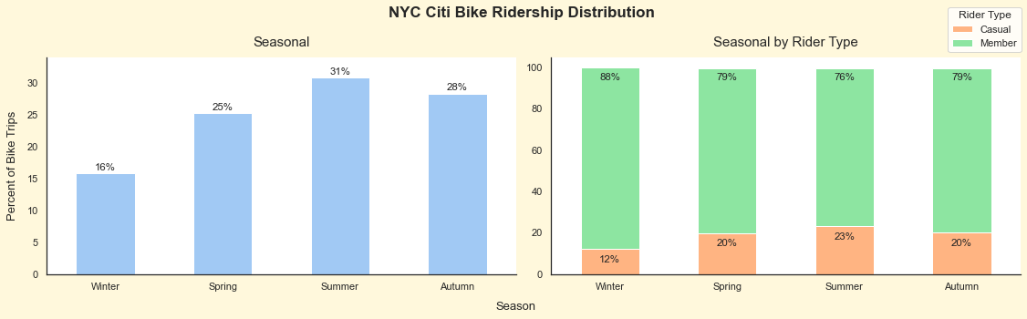
Seasonal Distribution
Summer held the majority share at 31% of total trips, while Winter contributed 16%.
Summar held the majority share of Casual Riders, 23%, while Winter held the least at 12%.

Slide 9
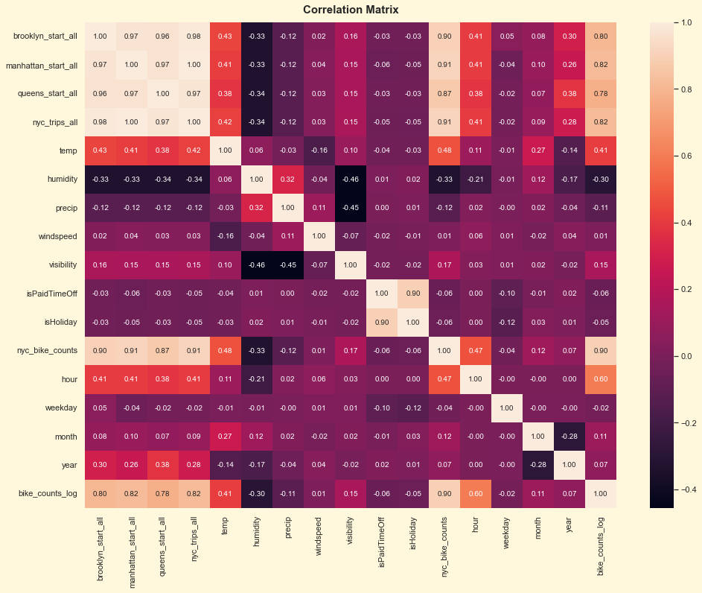
Correlation Analysis
Temperature and hour had the most substantial positive correlation with ridership, while humidity had the highest negative correlation.

Slide 10
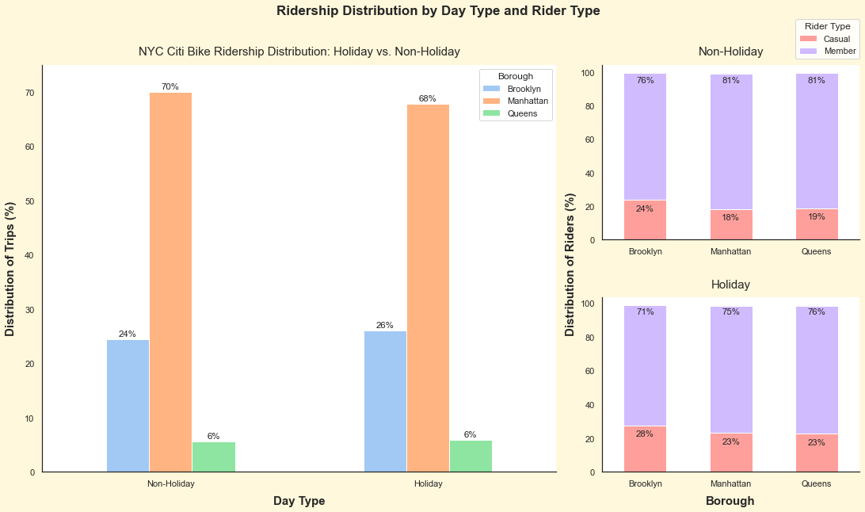
Holiday Influence
Holidays triggered a decline in Manhattan's ridership, an uptick in Brooklyn, and relatively unaffected patterns in Queens.
Despite the overall decrease in Manhattan's ridership, casual riders increased across all boroughs during the same period.
Overall Ridership Shift
Manhattan: - 2%
Brooklyn: + 2%
Casual Ridership Shift
Brooklyn: + 4%
Manhattan: + 5%
Queens: + 4%

Slide 11
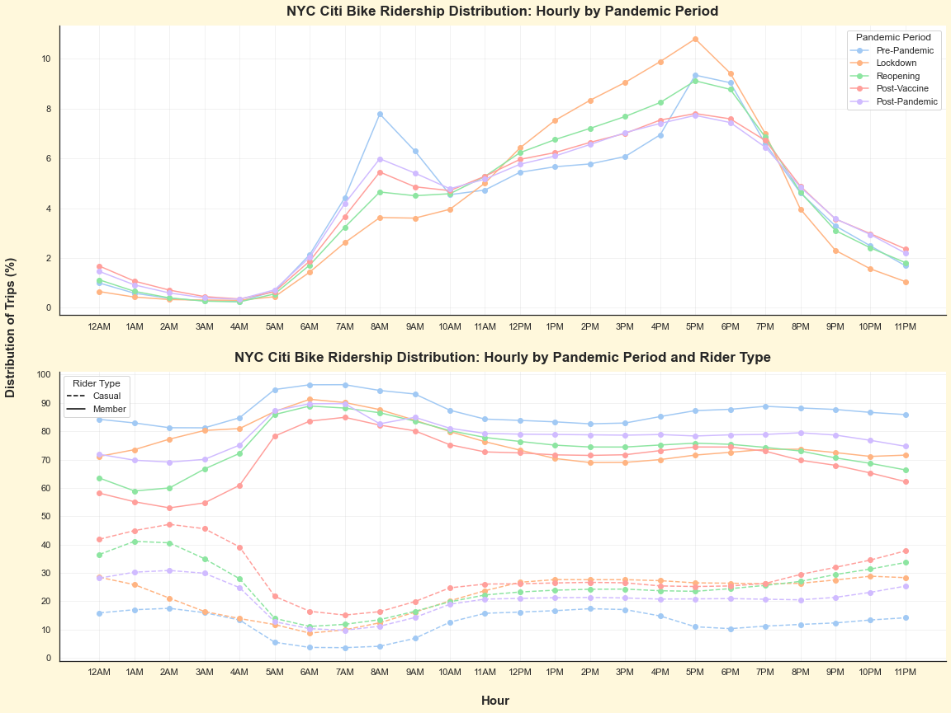
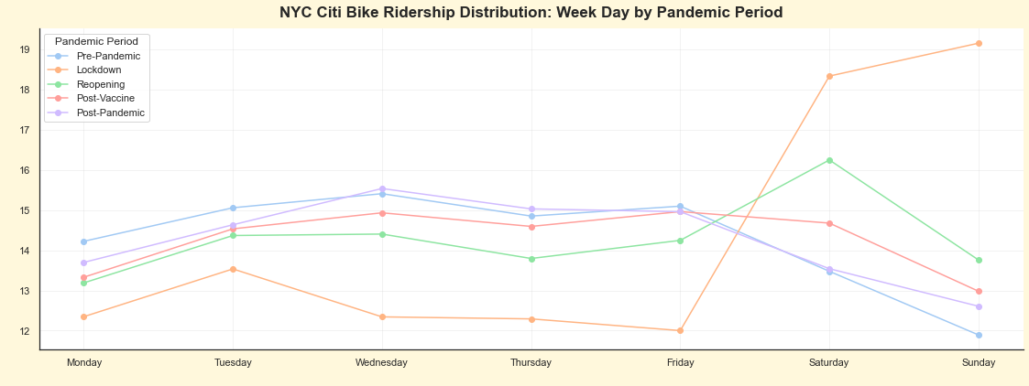
Covid-19 Impact
Significant shifts in ridership occurred during morning and evening rush hours. Morning rush hour trips declined during lockdown, and evening rush hour trips increased.
Shift in Ridership: Pre-Pandemic to Lockdown
Hourly
8AM: - 4%
11AM-5PM: + 3%
Weekday
Monday-Friday: - 3%
Saturday: + 4%
Sunday: + 7%

Slide 12
The Findings
Model Performance
Predictive Accuracy Analysis
Model Development

Slide 13
Model Performance
 | Algorithm 1 | Algorithm 2 | % Difference
Initial Model | 73.30% | 73.23% | -0.10%
Final Model (6-Month Horizon) | 81.66% | 82.34% | +0.83%
% Difference | +11.41% | +12.44%
The Accuracy Rate measures how close the predictions are to the actual ridership volume.

Slide 14
Model Performance
 | Algorithm 1 | Algorithm 2 | % Difference
Initial Model | 73.30% | 73.23% | -0.10%
Final Model (6-Month Horizon) | 81.66% | 82.34% | +0.83%
% Difference | +11.41% | +12.44%
The Accuracy Rate measures how close the predictions are to the actual ridership volume.

Slide 15
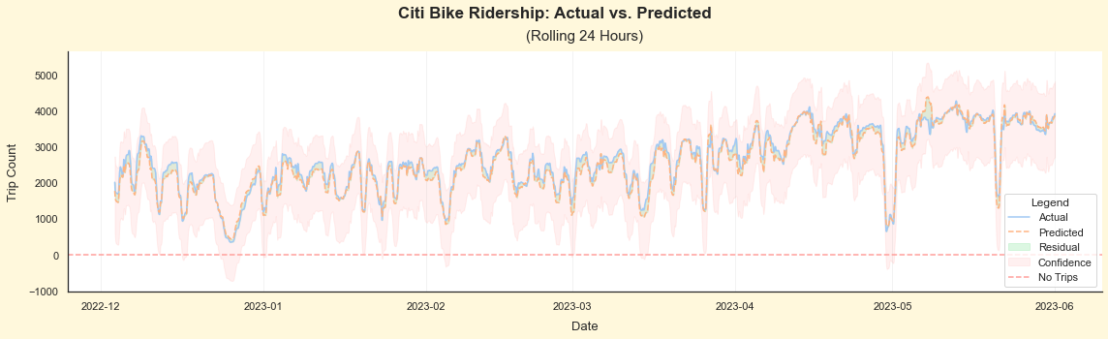
Predictive Accuracy Analysis
A predictive accuracy rate of 82.34% equates to a difference of ~ 90 trips per hour throughout New York City.
The highest predictive accuracy is achieved at a 6-month forecast horizon (interval).
The lower and upper confidence intervals are approximately 51.84% to approximately 132.75% of the actual ridership volume.

Slide 16
Limitations
The study's models capture a lot, but not everything. Just like a weather forecast might miss some changes, our models might not cover all the factors affecting ridership, like sudden events or unique situations.
While we've done our best to predict ridership, some things are hard to foresee. Like unexpected rain on a sunny day, external factors can sometimes throw off our predictions.
Our data is like pieces of a jigsaw puzzle. Sometimes, we might not have all the pieces we need, which can affect the accuracy of our predictions.
Our models assume that some relationships are straight lines, but real life can be more curved. Imagine estimating a car's speed based on its age – it's not always straightforward.
The future isn't always like the past. Our models are based on historical data, but if things change drastically, like new regulations or behaviors, it might affect our predictions.
While our models are helpful, they're not magic. They give us probabilities, not certainties. Just like a coin toss can be heads or tails, our predictions can have different outcomes.
Simplification of Reality
Predicting the Unpredictable
Missing Pieces of the Puzzle
Linear Assumptions
Changing Scenarios
Not a Crystal Ball

Slide 17
Proposed Actions
Just as different recipes can make the same ingredients taste different, we're going to try various methods to make our data work better.
Think of it like investigating why some days the weather forecast isn't quite right. We'll look closer at why our predictions might not always match real life and find ways to improve them.
Imagine solving a mystery by gathering clues. We'll focus on choosing the most important clues from our data puzzle, so our predictions are based on the most meaningful information.
Just like roads can twist and turn, relationships in data can be more complex than straight lines. We'll explore ways to capture these curvier connections for more accurate predictions.
Imagine trying to guess a friend's next move in a game that keeps changing. We'll work on adapting our models to sudden shifts, like new rules in the game, to make sure our predictions stay relevant.
Think of it like betting on a game – we'll calculate the odds of different outcomes. Our predictions won't be perfect, but they'll give us a good sense of what's likely to happen.
Exploring Different Normalization Tricks
Digging Deeper into Unpredictability
Picking the Right Puzzle Pieces
Beyond Straight Lines
Keeping Up with Changes
Understanding Probabilities

Slide 18
Expected Benefits
Aim to improve prediction accuracy by at least 5% using advanced modeling techniques.
Optimized resource allocation for efficient Citi Bike operations.
Anticipated reduction of at least 8% in revenue prediction errors, leading to better financial planning.
Proactive measures enabled by predicting ridership trends.
Potential reduction of station downtime by at least 10%, minimizing disruptions.
Expected operational cost reduction of 12% through resource allocation and maintenance efficiency.
Increase accuracy of station expansion predictions by at least 20%.
Ensure strategic placement of new stations based on projected demand.
Boost confidence levels by at least 15% for strategic decisions based on analysis outcomes.
Enhanced Accuracy of Predictions
Improved Revenue Projection
Effective Operational Planning
Cost Savings
Informed Infrastructure Development
Empowered Decision-Making

